Slide 1
CSE327 Software Engineering
AKM iqtidar Newaz [IqN]
Lecture - 12

Slide 2
Factory Design Pattern
Suppose, We have a Battleship superclass that extends into different types of subclasses like Destroyer, Carrier… etc.
#include <iostream>
using namespace std;
class Battleship
{
public:
Battleship()
{
std::cout << "Battleship Created" << std::endl;
}
virtual void Fire() = 0;
virtual void Steer() = 0;
};
class Destroyer : public Battleship
{
public:
Destroyer()
{
std::cout << "Destroyer Created" << std::endl;
}
void Fire() override
{
std::cout << "Destoryer Fire" << std::endl;
}
void Steer() override
{
std::cout << "Destroyer Steer" << std::endl;
}
};
main.cpp
class Carrier : public Battleship
{
public:
Carrier()
{
std::cout << "Carrier Created" << std::endl;
}
void Fire() override
{
std::cout << "Carrier Fire" << std::endl;
}
void Steer() override
{
std::cout << "Carrier Steer" << std::endl;
}
};
main.cpp
int main() {
Destroyer d;
Carrier c;
d.Fire();
c.Fire();
return 0;
}

Slide 3
Factory Design Pattern
Factory Method is a creational design pattern that provides an interface for creating objects in a superclass, but allows subclasses to alter the type of objects that will be created.
Create objects without specifying the exact class of the object that will be created.
This means that before running the factory method, we don’t know which type of object we are going to get after the method completes.
The type of the object is determined at runtime: This flexibiltiy is crucial because if we knew the exact type at compile time, we would not need the factory method.
We need pointer or reference to a base class: We require a virtual factory method in the base class in order to call the correct instance methods of the object created by the factory method. This is polymorphism.
It provides an itnerface for creating objects in a superclass but allows subclasses to alter the type of objects that will be created.
This means, an interface declares a method for creating objects, but the actual implementation of that method is left to the subclasses. This allows subclasses to decide the type of object it wants to create without modifying the client code.

Slide 4
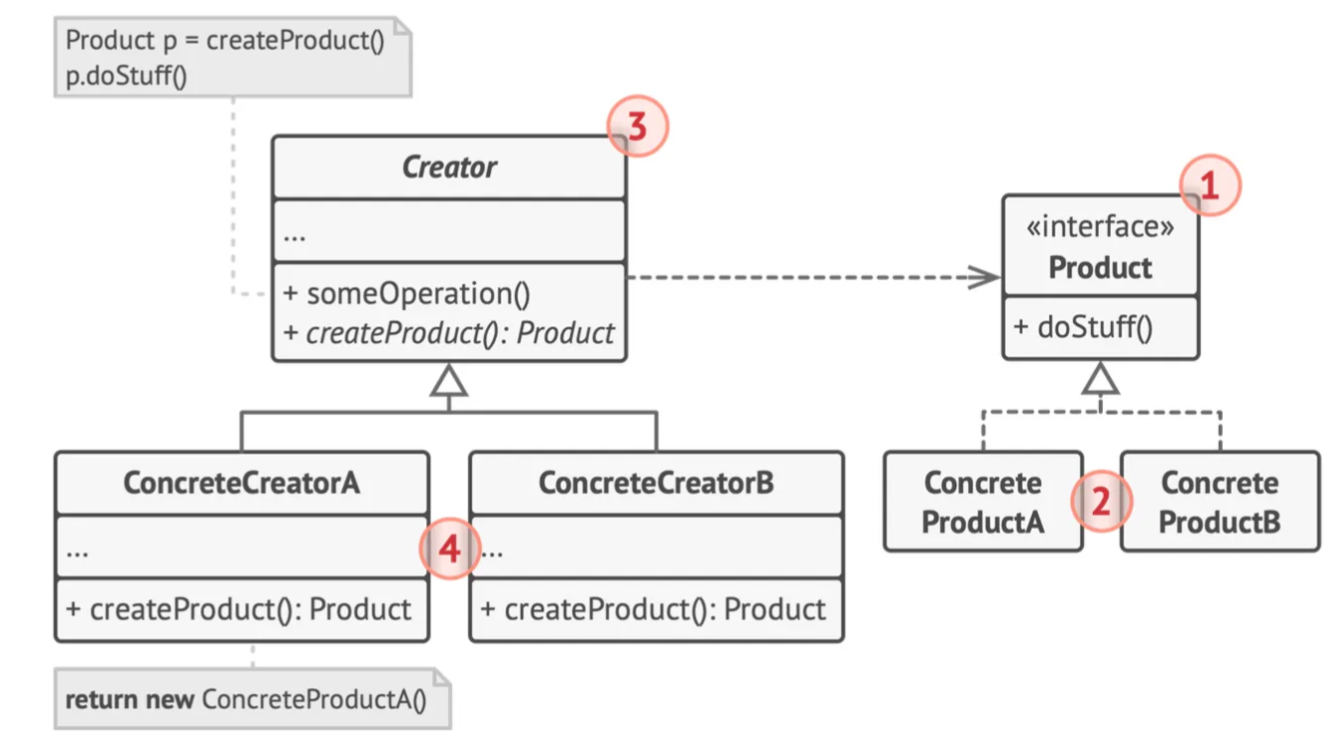
Factory Design Pattern
Product means the superclass, or interface, the objects we ought to create implements.
Concrete Products are the actual objects we ought to create.
In our previous example, BattleShip class is the Product, and Destroyer and Carrier are the Concrete Products.
Creator is the “Factory Class” which extends into Concrete Creators which will create the Concrete Products for us.
There will be a Concrete Creator — DestroyerCreator that creates Destroyer’s, and similarly a CarrierCreator that creates Carrier’s

Slide 5
Factory Design Pattern Steps to Follow
Step 1: Make all products follow the same interface. This interface should declare methods that make sense in every product.
Step 2: Add an empty factory method inside the creator class. The return type of the method should match the common product interface.
Step 3: In the creator’s code find all references to product constructors. One by one, replace them with calls to the factory method, while extracting the product creation code into the factory method.
Step 4: Now, create a set of creator subclasses for each type of product listed in the factory method. Override the factory method in the subclasses and extract the appropriate bits of construction code from the base method.

Slide 6
Example 1 - Code
main.cpp
#include <iostream>
using namespace std;
class Battleship
{
public:
Battleship()
{
cout << "Battleship Created" << endl;
}
virtual void Fire() = 0;
virtual void Steer() = 0;
virtual ~Battleship()
{
cout << "Battleship destroyed" << endl;
}
};
class Destroyer : public Battleship
{
public:
Destroyer()
{
cout << "Destroyer Created" << endl;
}
void Fire() override
{
cout << "Destroyer Fire" << endl;
}
void Steer() override
{
cout << "Destroyer Steer" << endl;
}
};
main.cpp

Slide 7
Example 1 - Code
// run-time polymorphism
class ShipCreator
{
public:
virtual Battleship *FactoryMethod() = 0;
virtual ~ShipCreator() {}
Battleship *CreateShip()
{
Battleship *ptr = this->FactoryMethod();
return ptr;
}
};
class CarrierCreator : public ShipCreator
{
public:
Battleship *FactoryMethod() override
{
return new Carrier();
}
};
class Carrier : public Battleship
{
public:
Carrier()
{
cout << "Carrier Created" << endl;
}
void Fire() override
{
cout << "Carrier Fire" << endl;
}
void Steer() override
{
cout << "Carrier Steer" << endl;
}
};
main.cpp
main.cpp

Slide 8
Example 1 - Code
class DestroyerCreator : public ShipCreator
{
public:
Battleship *FactoryMethod() override
{
return new Destroyer();
}
};
int main()
{
ShipCreator *creator = new CarrierCreator();
Battleship *battleship1 = creator->CreateShip();
battleship1->Fire();
battleship1->Steer();
cout << "\nSecond Battleship:\n";
creator = new DestroyerCreator();
Battleship *battleship2 = creator->CreateShip();
battleship2->Fire();
battleship2->Steer();
delete battleship1;
delete battleship2;
delete creator;
}
main.cpp
main.cpp
Output:
Battleship Created
Carrier Created
Carrier Fire
Carrier Steer
Second Battleship:
Battleship Created
Destroyer Created
Destroyer Fire
Destroyer Steer
Battleship destroyed
Battleship destroyed

Slide 9
Example 2 (Restaurant Order Processing)
Let’s say we want to work on a restaurant ordering system, which allows customers to order two types of foods: Pizza and Pasta.
A FoodFactory could be used to create different types of food items (e.g., PizzaFactory, PastaFactory). Each factory would handle the specifics of creating a particular food item, including ingredients, preparation steps, and pricing calculations.

Slide 10
Example 2 (Restaurant Order Processing)
#pragma once
#include <iostream>
#include <unordered_map>
usingnamespace std;
// Enum for food types
enumclass FoodType
{
PIZZA,
PASTA
};
// Abstract Product
class FoodItem
{
public:
virtualvoid prepare() const = 0;
virtual ~FoodItem() = default;
};
// Concrete Products
class CheesePizza : public FoodItem
{
public:
void prepare() constoverride
{
cout <<"Preparing Cheese Pizza"<< endl;
}
};
class Pepperoni : public FoodItem
{
public:
void prepare() constoverride
{
cout <<"Preparing Pepperoni Pizza"<< endl;
}
};
class Spaghetti : public FoodItem
{
public:
void prepare() constoverride
{
cout <<"Preparing Spaghetti"<< endl;
}
};
foodItem.h
foodItem.h

Slide 11
Example 2 (Restaurant Order Processing)
#pragma once
#include "foodItem.h"
// Abstract Factory
class FoodFactory
{
public:
virtual FoodItem *createFood() const = 0;
};
// Concrete Factory
class CheesePizzaFactory : public FoodFactory
{
public:
FoodItem *createFood() constoverride
{
returnnew CheesePizza();
}
};
class PepperoniPizzaFactory : public FoodFactory
{
public:
FoodItem *createFood() constoverride
{
returnnew Pepperoni();
}
};
class SpaghettiPizzaFactory : public FoodFactory
{
public:
FoodItem *createFood() constoverride
{
returnnew Spaghetti();
}
};
#pragma once
#include "foodFactory.h"
#include "foodItem.h"
#include <unordered_map>
// Singleton Factory Registry
class FactoryRegistry
{
public:
static FactoryRegistry &getInstance()
{
static FactoryRegistry instance;
return instance;
}
void registerFactory(FoodType type, FoodFactory *factory) // Fixed function name
{
factories[type] = factory;
}
FoodFactory *getFactory(FoodType type) const
{
auto it = factories.find(type);
if (it != factories.end())
{
return it->second;
}
returnnullptr;
}
private:
FactoryRegistry() = default;
unordered_map<FoodType, FoodFactory *> factories;
};
foodFactory.h
factoryRegister.h

Slide 12
Example 2 (Restaurant Order Processing)
#include "factoryRegister.h"
#include "foodFactory.h"
#include "foodItem.h"
int main()
{
// Get the singleton instance of the FactoryRegistry
FactoryRegistry &registry = FactoryRegistry::getInstance();
// Register Factories
registry.registerFactory(FoodType::PIZZA, new CheesePizzaFactory());
registry.registerFactory(FoodType::PASTA, new SpaghettiPizzaFactory());
// Simulate a Customer Order
FoodType cutomerOrder = FoodType::PIZZA;
FoodFactory *factory = registry.getFactory(cutomerOrder);
if (factory)
{
FoodItem *food = factory->createFood();
food->prepare();
}
else
{
cout <<"No factory found for the requested food type!"<< endl;
}
return0;
}
main.cpp
Output:
Preparing Cheese Pizza

Slide 13
Example 3 - PizzaOrdering (Code)
#pragma once
#include <iostream>
#include <string>
#include <vector>
usingnamespace std;
class Pizza
{
public:
Pizza() = default;
virtual ~Pizza() = default;
virtualvoid prepare() const;
virtualvoid bake() const
{
cout <<"Bake for 25 minutes at 350"<< endl;
}
virtualvoid cut() const
{
cout <<"Cutting the pizza into diagonal slices"<< endl;
}
virtualvoid box() const
{
cout <<"Place pizza in official PizzaStore box"<< endl;
}
protected:
string name{};
string dough{};
string sauce{};
vector<string> toppings{};
};
pizza.h
pizza.h
inline void Pizza ::prepare() const
{
cout <<"Preparing "+ name << endl;
cout <<"\nTossing dough...\n";
cout <<"Adding sauce...\n";
cout <<"Adding toppings...\n";
for (constauto &topping : toppings)
{
cout <<" "+ topping << endl;
}
}

Slide 14
Example 3 - Pizza Store Ordering (Code)
#pragma once
#include "pizza.h"
class ClamsPizza : public Pizza
{
public:
ClamsPizza();
};
inline ClamsPizza ::ClamsPizza()
{
name ="Clams Pizza";
dough ="Thin Crust Though";
sauce ="Mariana Sauce";
toppings.push_back("Grated Regiano Clam");
toppings.push_back("Fresh Clams");
}
clamsPizza.h
#pragma once
#include "pizza.h"
class CheesePizza : public Pizza
{
public:
CheesePizza();
};
inline CheesePizza ::CheesePizza()
{
name ="Cheese Pizza";
dough ="Thin Crust Dough";
sauce ="Mariana Sauce";
toppings.push_back("Grated Regiano Cheese");
toppings.push_back("Shredded Cheese");
}
cheesePizza.h
#pragma once
#include "pizza.h"
class VeggiePizza : public Pizza
{
public:
VeggiePizza();
};
inline VeggiePizza ::VeggiePizza()
{
name ="Veggie Pizza";
dough ="Thin Crust Dough";
sauce ="Marinara sauce";
toppings.push_back("Grated Regiano Veggie");
toppings.push_back("Fresh veggies");
}
veggiePizza.h

Slide 15
Example 3 - Pizza Store Ordering (Code)
#pragma once
#include "cheesePizza.h"
#include "clamsPizza.h"
#include "pizza.h"
#include "veggiePizza.h"
#include <memory>
#include <string>
usingnamespace std;
class PizzaFactory
{
public:
virtual Pizza *createPizza(string_view) const = 0; // Pure virtual function
virtual ~PizzaFactory() = default; // Virtual destructor
};
class VeggiePizzaFactory : public PizzaFactory
{
public:
Pizza *createPizza(string_view name) constoverride
{
returnnew VeggiePizza();
}
};
pizzaFactory.h
class CheesePizzaFactory : public PizzaFactory
{
public:
Pizza *createPizza(string_view name) constoverride
{
returnnew CheesePizza();
}
};
class ClamsPizzaFactory : public PizzaFactory
{
public:
Pizza *createPizza(string_view name) constoverride
{
returnnew ClamsPizza();
}
};

Slide 16
Example 3 - Pizza Store Ordering (Code)
#pragma once
#include "pizza.h"
#include "pizzaFactory.h"
#include <unordered_map>
class PizzaFactoryRegistry
{
public:
static PizzaFactoryRegistry &getInstance()
{
static PizzaFactoryRegistry instance;
return instance;
}
void registerFactory(const string &name, PizzaFactory *factory)
{
factories[name] = factory;
}
PizzaFactory *getFactory(const string &name)
{
auto it = factories.find(name);
if (it != factories.end())
{
return it->second;
}
returnnullptr;
}
private:
PizzaFactoryRegistry() = default;
unordered_map<string, PizzaFactory *> factories;
};
pizzaFactoryRegistry.h

Slide 17
Example 3 - Pizza Store Ordering (Code)
#pragma once
#include "pizzaFactoryRegistry.h"
#include "pizzaFactory.h"
#include "cheesePizza.h"
#include "clamsPizza.h"
#include "veggiePizza.h"
class PizzaStore
{
public:
PizzaStore(PizzaFactory *f) : factory(f)
{
// Get singleton instance of Factory Registry
PizzaFactoryRegistry &registry = PizzaFactoryRegistry::getInstance();
// Register Concrete Factories
registry.registerFactory("CheesePizza", new CheesePizzaFactory());
registry.registerFactory("ClamsPizza", new ClamsPizzaFactory());
registry.registerFactory("VeggiePizza", new VeggiePizzaFactory());
}
Pizza *orderPizza(string_view type);
private:
PizzaFactory *factory = nullptr;
};
inline Pizza *PizzaStore::orderPizza(string_view type)
{
auto pizza = factory->createPizza(type);
pizza->prepare();
pizza->bake();
pizza->cut();
pizza->box();
return pizza;
}
pizzaStore.h

Slide 18
Example 3 - Pizza Store Ordering (Code)
Output:
Preparing Cheese Pizza
Tossing dough...
Adding sauce...
Adding toppings...
Grated Regiano Cheese
Shredded Cheese
Bake for 25 minutes at 350
Cutting the pizza into diagonal slices
Place pizza in official PizzaStore box
Preparing Clams Pizza
Tossing dough...
Adding sauce...
Adding toppings...
Grated Regiano Clam
Fresh Clams
Bake for 25 minutes at 350
Cutting the pizza into diagonal slices
Place pizza in official PizzaStore box
#include "pizzaFactory.h"
#include "pizzaStore.h"
#include "veggiePizza.h"
#include "clamsPizza.h"
#include "pizzaFactoryRegistry.h"
#include "cheesePizza.h"
#include <memory>
int main()
{
auto factory = new CheesePizzaFactory(); // Create Facotry
auto pizzaStore = PizzaStore(factory); // Create store and pass it factory
string customerOrder1 = "CheesePizza";
auto pizza = pizzaStore.orderPizza(customerOrder1); // Order pizza from store
cout <<"\n\t";
auto factory2 = new ClamsPizzaFactory();
auto store = PizzaStore(factory2);
string customerOrder2 = "ClamsPizza";
auto pizza2 = store.orderPizza(customerOrder2);
}
main.cpp

